Slide 1

Stats 101 Session 2

Slide 2
Distributions

Slide 3
Common Distribution Types
Bernoulli Distribution
Binomial Distribution
Uniform Distribution
Normal Distribution
Poisson Distribution
Exponential Distribution

Slide 4
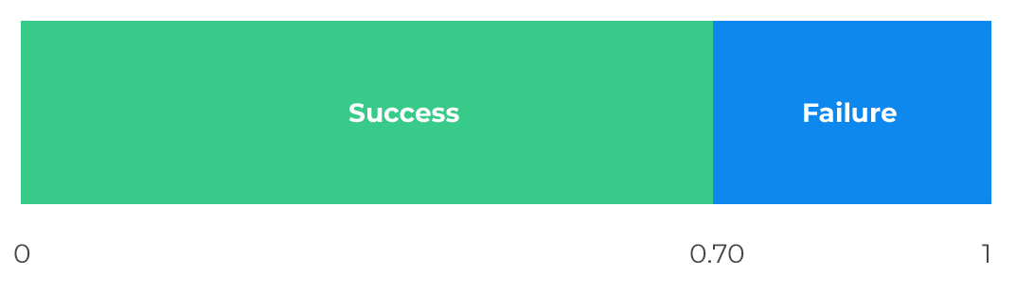
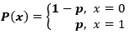
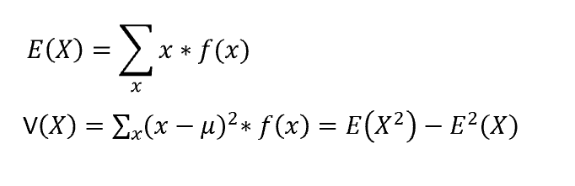
Bernoulli Distribution
Bernoulli distribution has only two possible outcomes (1 or 0) and a single trial
Heads or Tails when you toss a coin
Student will pass or fail an exam
A Random variable with Bernoulli distribution has:
Probability of success, say p
Probability of failure, say q or 1-p
Probability mass function:
Expected value of a random variable X:
E(X) = 1*p + 0*(1-p) = p
Variance of a random variable:
V(X) = E(X²) – [E(X)]² = p – p² = p(1-p)

Slide 5
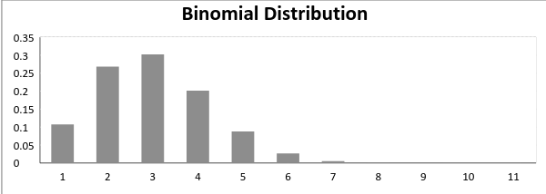
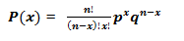
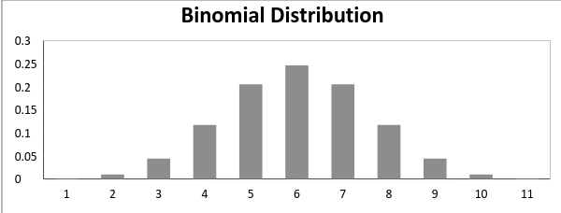
Binomial Distribution
A distribution where only two outcomes are possible and where the probability of success and failure is same for all the trials
Each trial is independent and there are only two possible outcomes in a trial- either a success or a failure.
A total number of n identical trials are conducted.
The probability of success and failure is same for all trials
Mathematical representation:
Mean & variance of variable X:
n*p n*p*q

Slide 6
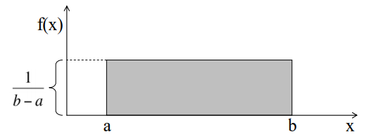
Uniform Distribution
Uniform distribution has same probability of each outcome
When you roll a fair die, the outcomes are 1 to 6
Probability of each card in deck of cards
Density function of uniformly distributed variable X :
Mean & variance of variable X:
(a+b)/2 (b-a)²/12

Slide 7
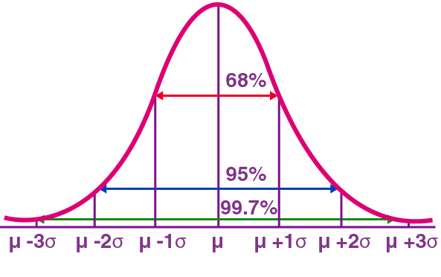
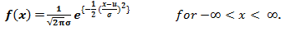
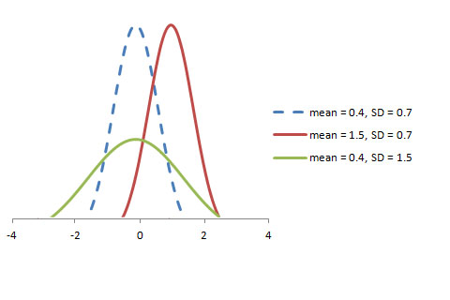
Normal Distribution
Normal distribution represents the behavior of most of the situations in the universe with following characteristics:
The mean, median and mode of the distribution coincide.
The curve of the distribution is bell-shaped and symmetrical about the line x=μ.
The total area under the curve is 1.
Exactly half of the values are to the left of the center and the other half to the right.
The probability distribution function of Normal distribution:
Mean & variance of variable X: µ & σ^2
Standard normal distribution: distribution with mean 0
and standard deviation 1

Slide 8
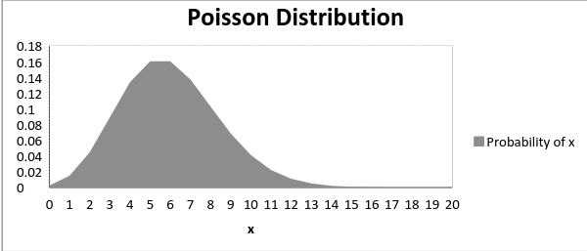
Poisson Distribution
Poisson Distribution is applicable in situations where events occur at random points of time and space wherein our interest lies only in the number of occurrences of the event.
The number of emergency calls recorded at a hospital in a day.
The number of thefts reported in an area on a day.
Assumptions of Poisson distribution:
Any successful event should not influence the outcome of another successful event.
The probability of success over a short interval must equal the probability of success over a longer interval.
The probability of success in an interval approaches zero as the interval becomes smaller.
Probability mass function of Poisson distribution:
Expected value & Variance of Poisson distribution: λ
f(x) =(e^{– λ} λ^{x})/x!
x is a Poisson random variable
λ is an average rate of value

Slide 9
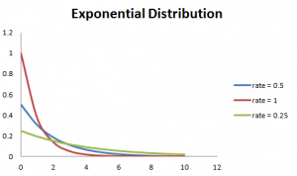
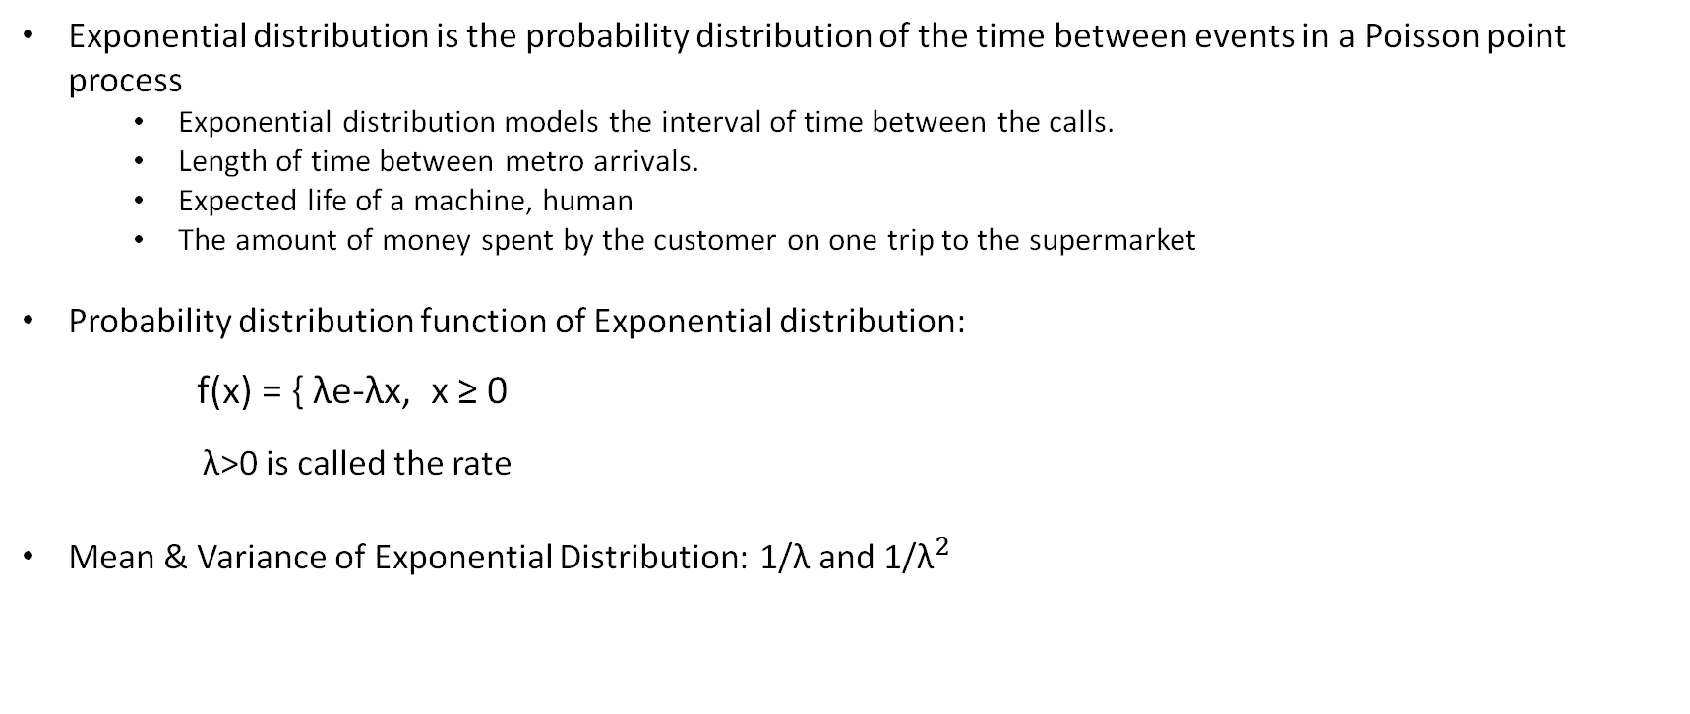
Exponential Distribution
Exponential distribution is the probability distribution of the time between events in a Poisson point process
Exponential distribution models the interval of time between the calls.
Length of time between metro arrivals.
Expected life of a machine, human
The amount of money spent by the customer on one trip to the supermarket
Probability distribution function of Exponential distribution:
f(x) = { λe-λx, x ≥ 0
λ>0 is called the rate
Mean & Variance of Exponential Distribution: 1/λ and ${\text{1/}\text{λ}}^{2}$

Slide 10
Example
Telephone calls arrive at an exchange according to the Poisson process at a rate λ= 2/min. Calculate the probability that exactly two calls will be received during each of the first 5 minutes of the hour.

Slide 11
Example
Telephone calls arrive at an exchange according to the Poisson process at a rate λ= 2/min. Calculate the probability that exactly two calls will be received during each of the first 5 minutes of the hour.
Assume that “N” be the number of calls received during a 1 minute period.
Therefore,
P(N= 2) = (e⁻². 2²)/2!
P(N=2) = 2e⁻².
Now, “M” be the number of minutes among 5 minutes considered, during which exactly 2 calls will be received. Thus “M” follows a binomial distribution with parameters n=5 and p= 2e⁻².
P(M=5) = 32 x e⁻¹⁰
P(M =5) = 0.00145, where “e” is a constant, which is approximately equal to 2.718.

Slide 12
Overview of Tests

Slide 13
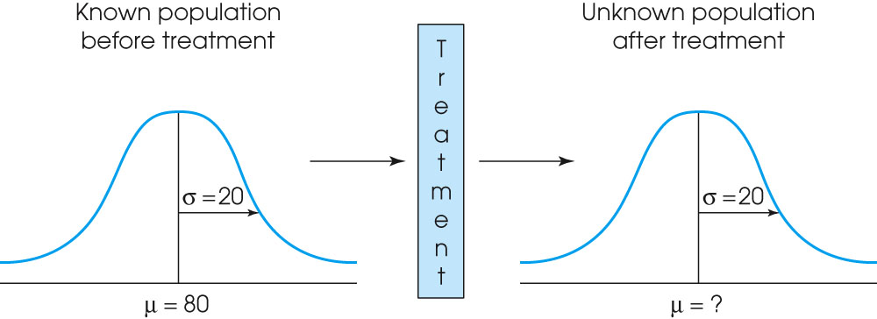
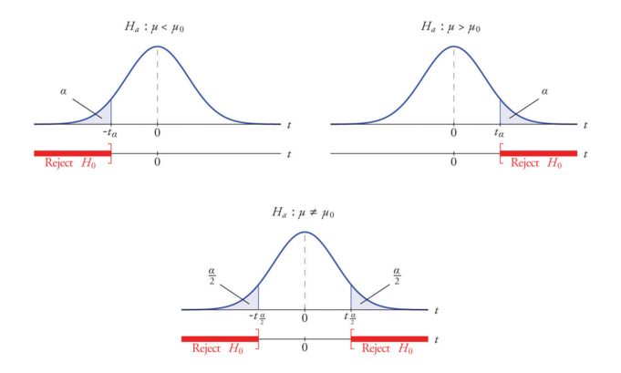
Statistical Test
The hypothesis test is used to evaluate the results from a research study in which
A sample is selected from the population.
The treatment is administered to the sample.
After treatment, the individuals in the sample are measured.
Hypothesis:
Null: Given two sample means are equal
Alternate: Given two sample means are not equal
1 tail test vs 2 tail test
Statistical significance vs Directional analysis

Slide 14
Components to a statistical test
Dataset with groups for comparison
Null Hypothesis
P – value
Significance level (alpha)
Types of errors

Slide 15
Example
Blood Glucose levels for obese patients have a mean of 100 with a standard deviation of 15. A researcher thinks that a diet high in raw cornstarch will have a positive or negative effect on blood glucose levels. A sample of 30 patients who have tried raw cornstarch diet have a mean glucose level of 140. Test the hypothesis for 95% confidence that the raw starch had an effect

Slide 16
Hypothesis
H0: Mean = 100
Ha: Mean ≠ 100
α = 0.05 or 5%

Slide 17
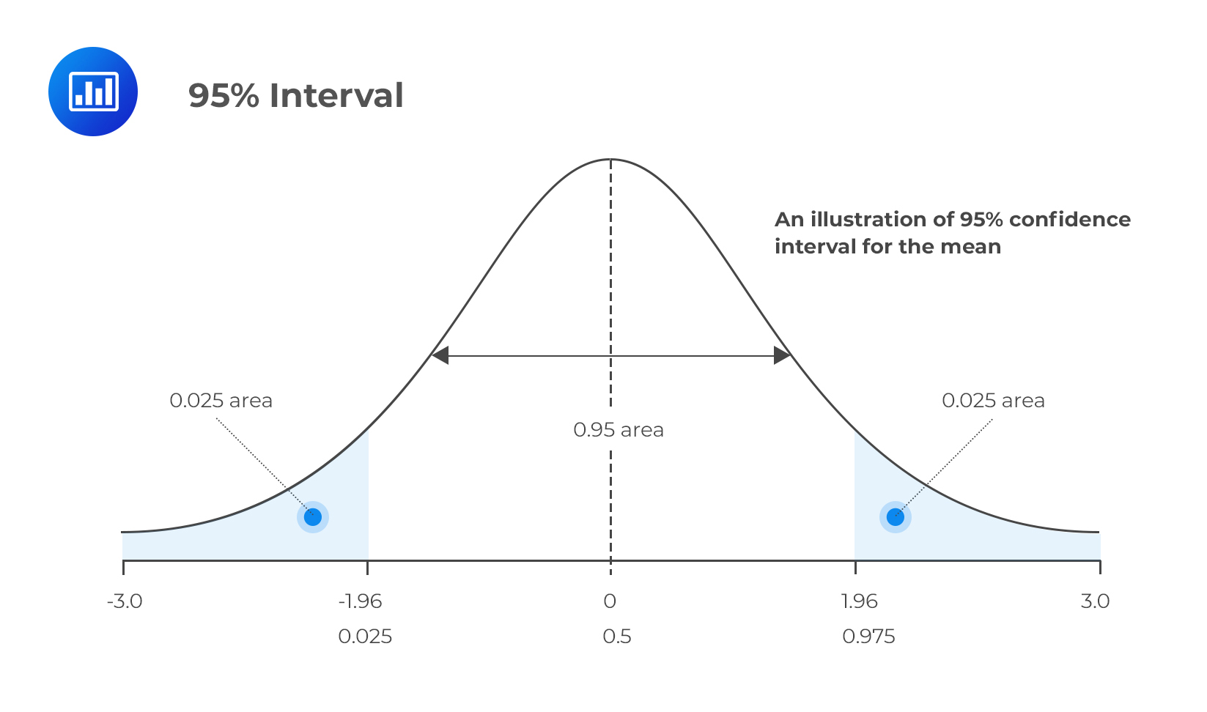
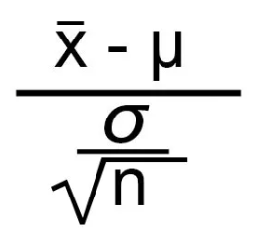
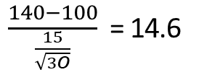
Analysis
Z-score for 47.5% = 1.96 (taken from z table)
Test Statistic =
$\frac{140−100}{\frac{15}{\sqrt{3O}}}$ = 14.6
Reject Null Hypothesis
Accept Alternate Hypothesis => Mean ≠ 100 and there is a significant difference in glucose levels

Slide 18
Hypothesis
H0: Higher number of reviews for a positively rated product will lead to better perceptions of the product until a review perception threshold is reached

Slide 19



Experiment
Design: Post-test only, control group design
Control Group: R -- O(Willingness to Purchase)
Treatment Group: R Low # reviews O(Willingness to Purchase)
Treatment Group: R Medium # reviews O(Willingness to Purchase)
Measurements
Quality of product
Value of product
Confidence in product
Confidence in reviews

Slide 20
Analysis
The difference in perception of reviews led to a significant difference in purchase intent of the product between the low review and the other groups
Significant difference between low # and mid # reviews (p = 0.0282)
Significant difference between low # and high # reviews (p = 0.0145)
Even with a high rating of 4 stars, once a threshold of lower number of reviews was breached, the intent to purchase reduced significantly

Slide 21
Tests/ Models – Questions to ask
What are the variables involved?
Is one of the variables the dependent variable (Y)?
What is the measurement scale of each variable: nominal, ordinal, or ratio?
Is there a dependent variable?
Yes
No
Tests and models in the next slides
Cluster analysis
Dimension reduction
Others …

Slide 22
Tests Overview
Y
Nominal
Ordinal or ratio
X is nominal
X is ordinal or ratio
X is nominal with 2 levels
X is nominal with 3+ levels
X is ordinal or ratio
Chi Square test
Switch X and Y
Normality assumed:
T test
Normality not assumed:
Mann-Whitney test
Normality assumed:
Oneway ANOVA
Normality not assumed:
Kruskal-Wallis test
otherwise:
Pearson correlation
if both ordinal:
Spearman correlation
Non-Parametric Tests

Slide 23
Models Overview
Y
Normal
Nominal with 2 levels
Nominal with 3+ levels
Ordinal
Counts
Linear Regression
Logistic Regression
Probit Regression
Multinomial Regression
Multinomial Regression
Multinomial Regression
Regression tree,
K-nearest
neighbors,
etc.
Linear discriminant analysis,
K-nearest neighbors,
Classification trees, etc.
Non-Parametric Variations

Slide 24
Power Analysis

Slide 25
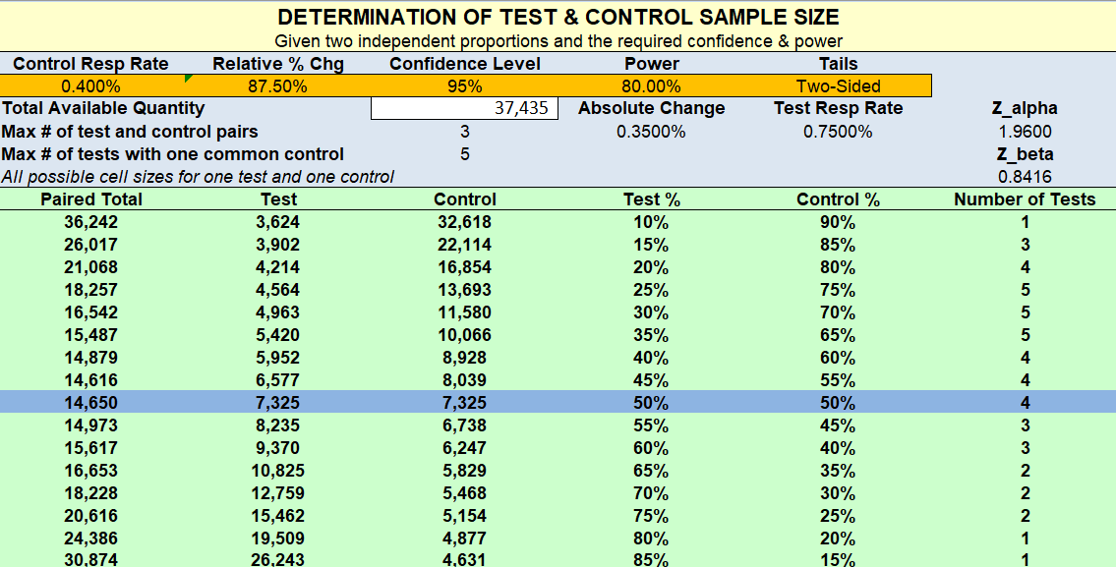
Test vs Control
Determine comparison groups volumes by evaluating:
Available budget of the campaign
Base conversion rate
Power required in the test
Confidence levels required
1-side vs 2-side test

Slide 26
What is Power of a test?
The statistical power of a hypothesis test is the probability of detecting an effect, if there is a true effect present to detect.

Slide 27
Univariate vs Bivariate Analysis

Slide 28
Univariate vs Bivariate
Univariate Analysis: One variable analyzed at a time
Bivariate Analysis: Two variables analyzed at a time
Multivariate Analysis: More than two variables analyzed at a time
Types of Analysis:
Descriptive Analysis:
Transformation of raw data
Deals with summary measures related to data
Ex: What is the average age of the data?
Inferential Analysis:
Carried out after descriptive analysis
Inferences drawn on parameters
Ex: Is the average age of population different from 35?

Slide 29
Sample Univariate Analysis
Mean
Median
Mode
Range
Variance
Standard Deviation
Coefficient of variation

Slide 30
Sample Bivariate Analysis
Cross Tabulation
Spearman's rank correlation coefficient (used in case of ordinal data)
Pearson's linear correlation coefficient
Regression Analysis
Chi Square test
T test

Slide 31
Assignment

Slide 32
Thank You
We Blend in to Create Results that Stand Out

